Slide 1
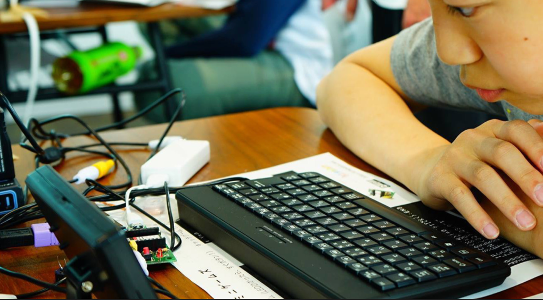

はじめてのプログラミング
with IchigoJam
(IchigoDake + IchigoDyhook)
First Programming with IchigoJam
IchigoJam P
FONT: こども丸ゴシック
FONT: IchigoJam 1.4 / IchigoJam-GRAPH CC BY IchigoJam / 🎈 BALLOON | FU-SEN
https://ichigojam.net/

Slide 2
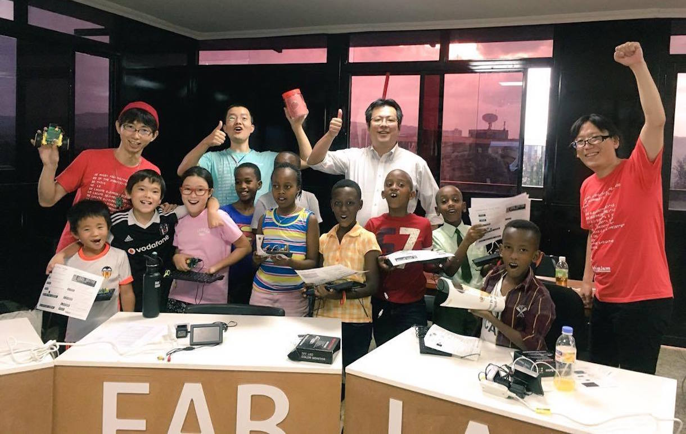

We’re PCN (Programming Club Network)

Slide 3
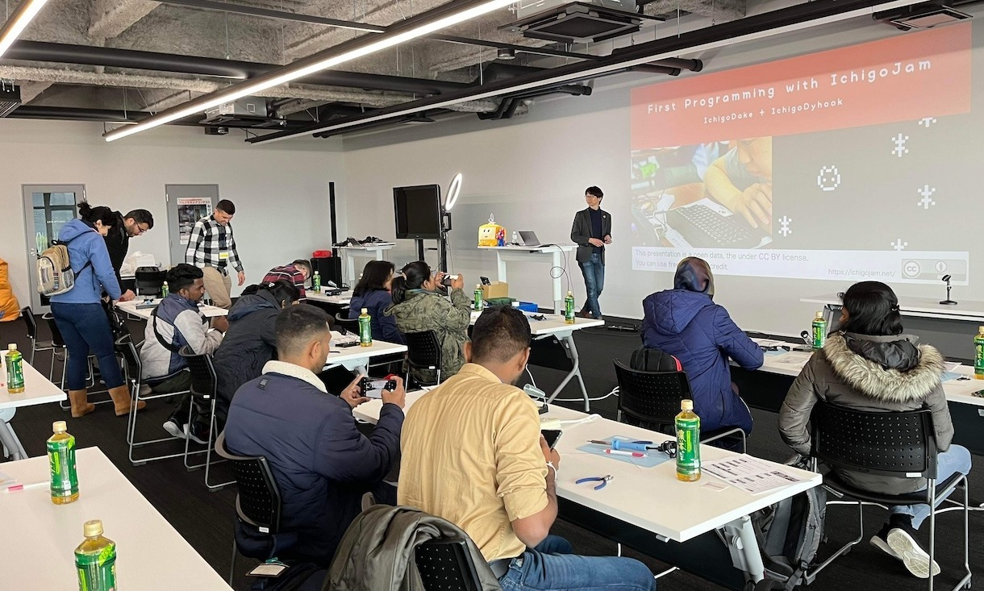
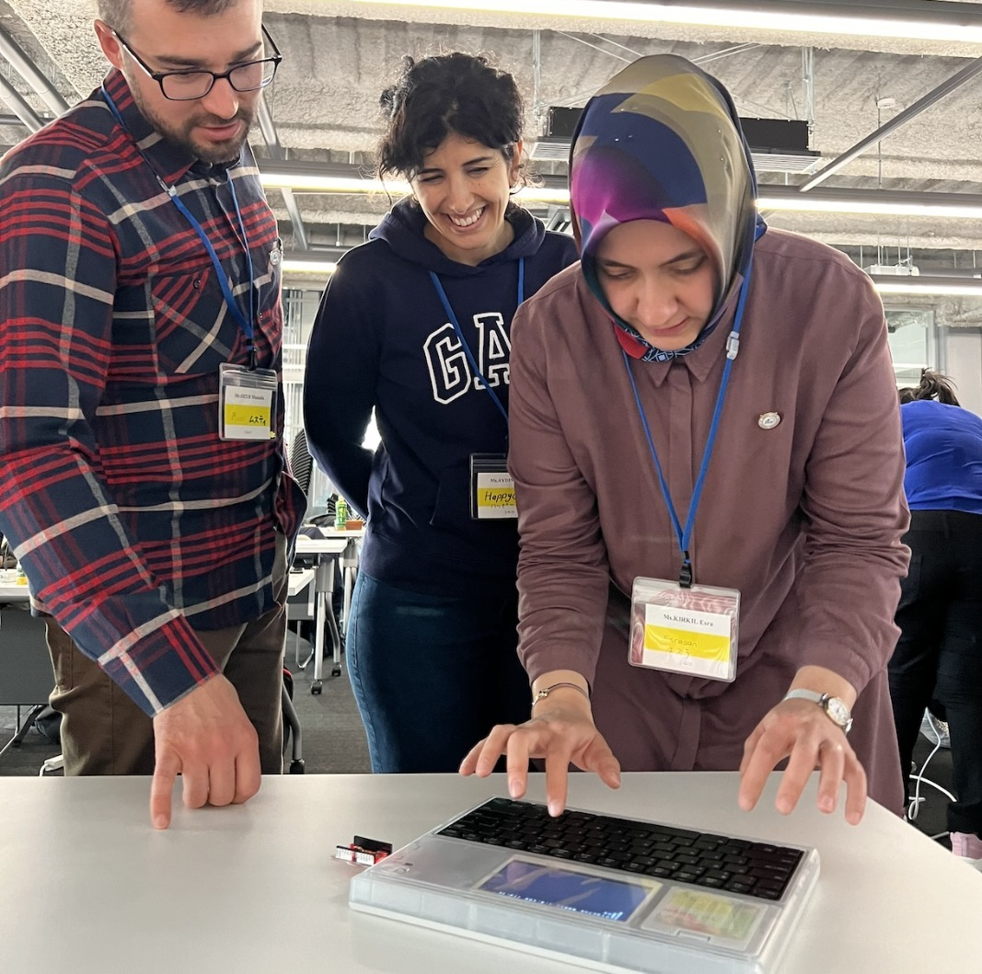
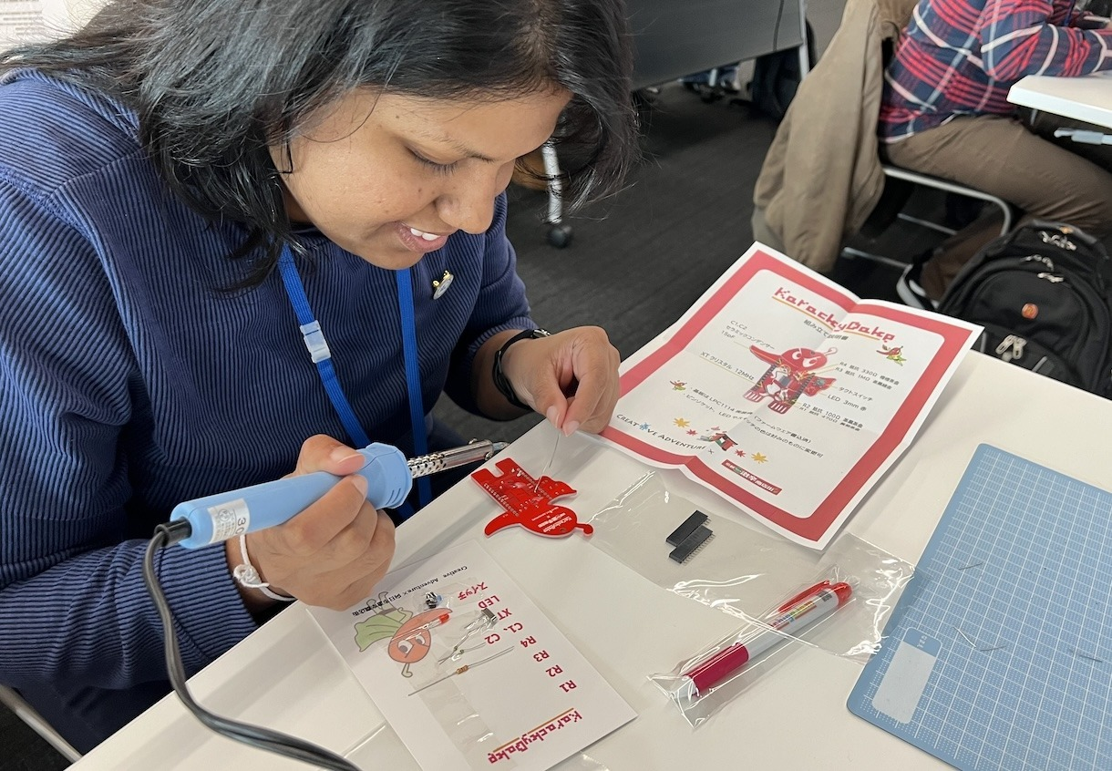
for Sri Lanka and Türkiye
with JICA in Japan

Slide 4

Robot Contest for Kids
Echizen Crab Robot Contest from FUKUI
Kids Lecture
in companies on Saturday
Every Winter
This year Japan cup!
https://kani-robocon.com/

Slide 5

IchigoJam ＆ IT Boot Camp→Creative Person
First Programming
in Elementary School
Robot and
Software Contests
Innovators!

Slide 6
Do you like computers?

Slide 7

Let’s befriend
computers more!

Slide 8
IchigoJam
$15 personal compute
TV
at home
$10 keyboard
$1 microUSB
as power src
https://hello002.stores.jp/items/5b39eae95496ff652b0001a7

Slide 9

IchigoJam
= Strawberry Jam
&
$15 PC

Slide 10

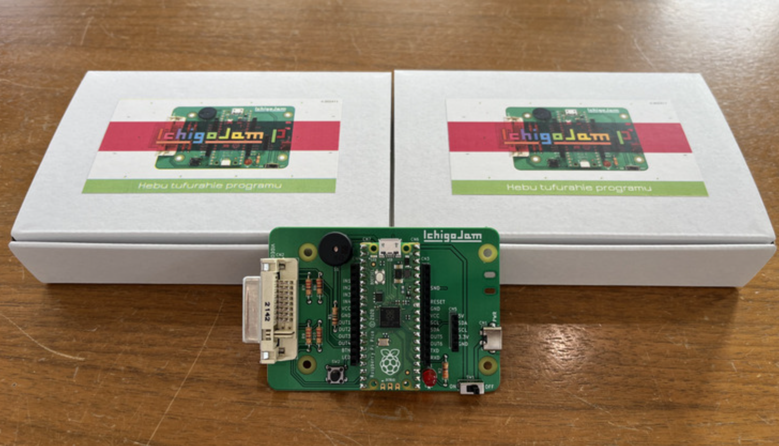

Latest Version
IchigoJam P

Slide 11
IchigoJam P
featuring Raspberry Pi Pico

Slide 12
This is a computer!
Just $1！
（IchigoJam P price is $20〜）

Slide 13
Let’s talk with
Computer!

Slide 14
・・・
（I have no ears）
Hello!

Slide 15
Let’s Set up!

Slide 16

Monitor
USB OTG
Keyboard
DVI
USB-C
HDMI
IchigoJam P
Power Source

Slide 17
Monitor
Keyboard
ON
Power Source

Slide 18
IchigoJam BASIC
OK
Blinking is the cursor!

Slide 19
IchigoJam BASIC
OK
A
Type 「A」 by your keyboard

Slide 20
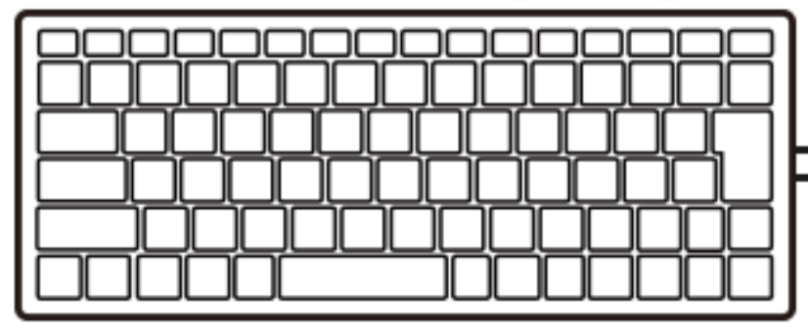
IchigoJam BASIC
OK
A
A
Enter key

Slide 21
IchigoJam BASIC
OK
A
Syntax error
A
エンターキー

Slide 22
?
I don’t
Know.
A
Syntax error

Slide 23
To light up this LED
by the computer
IchigoJam P

Slide 24
LED1
1
E
D
L
L E D 1 Enter

Slide 25
!
*
I know it!
OK
LED1

Slide 26
LED0
0
E
D
L
L E D 0 Enter

Slide 27
!
I know it!
OK
LED0

Slide 28
LED1
1
E
D
L
L E D 1 Enter

Slide 29
LED0
0
E
D
L
L E D 0 Enter

Slide 30
IchigoJam Special
Pressing Alt Key and type「C」
+
C
Alt
c
C
Alt

Slide 31
If you want to type the character on above,
be pressing 「shift」key
:
;
+
:
shift
;
Shift

Slide 32
c:
1
Hit the Backspace key
to remove characters

Slide 33

Turn the light on.
Turn the light off.
LED1:LED0
Shift+;
:
Colon
;
Semicolon

Slide 34
?
I know it!
LED1:LED0
OK

Slide 35
LED1:LED0
OK
1
↑
Hit the UP cursor key twice

Slide 36
LED1:LED0
OK
1
Hit the enter key again

Slide 37
Quiz time!

Slide 38

CPU
How many times
can this $1 computer
calculate in 1 second?

Slide 39
CPU
250 million times in 1 second

Slide 40
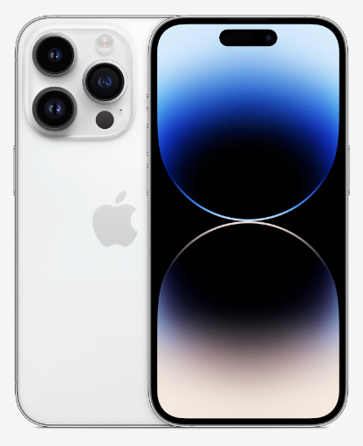
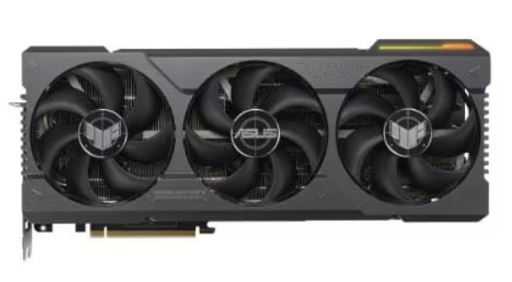
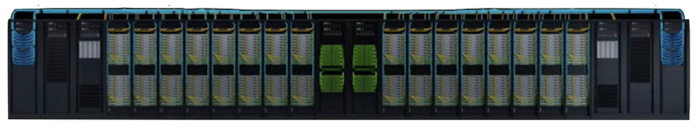
IchigoJam P | iPhone 16 Pro | NVIDIA 4090 | NVIDIA DGX GH200
250M | 36T | 1300T | 1E
IchigoJam x n? | 144k | 5M | 4G
$15 | $1500 | $3000 | $?M
CC BY IchigoJam
(C)Apple
(C)NVIDIA
(C)NVIDIA

Slide 41
WAIT

Slide 42
To wait seconds
WAIT180
How long did it take you
to press enter and then “OK”?

Slide 43
Turn the light on.
Wait 3 sec.
Turn the light off.
LED1:WAIT180:LED0
Shift+;
Shift+;
:
Colon
;
Semicolon

Slide 44
Write following it
And press the Enter key
To turn light on/off twice!
LED1:WAIT180:LED0:WAIT60:LED1:WAIT60:LED0
Light on twice

Slide 45
Can you flash that light 100 times?

Slide 46
LED1:WAIT10:LED0:WAIT10:LED1:WAIT10:LED0:WAIT10:LED1:WAIT10:LED0:WAIT10:LED1:WAIT10:LED0:WAIT10:LED1:WAIT10:LED0:WAIT10:LED1:WAIT10:LED0:WAIT10:LED1:WAIT10:LED0:WAIT10:LED1:WAIT10:LED0:WAIT10:LED1:WAIT10:LED0:WAIT10:LED1:WAIT10:LED0
Light up 10 times

Slide 47
Program

Slide 48
1 LED1:WAIT10
2 LED0:WAIT10
Space
Shift+;
:
Colon
;
Semicolon

Slide 49
Clear Screen!
F1
CLS
F1

Slide 50
Show me the program
I remember it!
LIST
F4

Slide 51
Run the program
F5
RUN
F5

Slide 52
Can you do
1000 times?

Slide 53
To repeat
3 GOTO1
F5
How many times?

Slide 54
Game with LED!
If the LED will be ON,
you’re WINNER!

Slide 55
press ESC key to stop
[ESC]key

Slide 56
Show me LIST of program
I remembered
LIST
F4

Slide 57
Let’s modify with cursor and backspace keys.
Press Enter key and F5 key after modifying.
1 LED1:WAIT3
2 LED0:WAIT10
3 GOTO1
F5
Cursor keys
You can modify freely

Slide 58
Press ESC key to stop
[ESC]key

Slide 59
Save the program
F3, 0, Enter
SAVE0
F3

Slide 60
To confirm
FILES4
F9
0 LED1:WAIT10
Check the file
F9

Slide 61
Monitor
Keyboard
OFF
Power Source

Slide 62
Monitor
Keyboard
Unplug
Power Source

Slide 63
Unplug
Keyboard
Power Source

Slide 64
Press and hold
the button
Power Source

Slide 65
ON
Power Source

Slide 66
You made a robot!
*

Slide 67
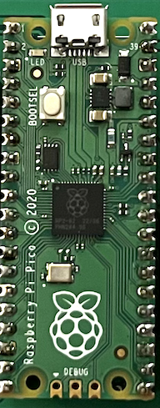
Computer + Power source =
Robot
Accessary
Anything!

Slide 68
Robots around you
by Panasonic

Slide 69
All someone
programed it!

Slide 70
Where are computers?

Slide 71
Let’s find computers
around you!

Slide 72
はじめてのプログラミング
with IchigoJam
(IchigoDake + IchigoDyhook)
Let’s make TV game!
with IchigoJam
This presentation is a open data, the under CC BY license.
You can use freely with the credit.
https://ichigojam.net/

Slide 73
OFF
Power Source

Slide 74
Plug
Keyboard
Power Source

Slide 75
Monitor
Keyboard
Plug
Power Source

Slide 76
Monitor
Keyboard
ON
Power Source

Slide 77
To load the program
F2, 0, Enter
LOAD0
F2

Slide 78
Show me List of program
I remembered it
LIST
F4

Slide 79
To start the new program
To be new!
NEW

Slide 80
Show me list of program
I forgot
LIST
F4

Slide 81
Colon
(Shift)
10 CLS:X=15
Equal
First, clear screen
=
;
Shift

Slide 82
Run the program
I run the program numerical order
RUN
F5

Slide 83
(Shift)
Question
?X
Symbols
What is X?

Slide 84

memory by computer
Computer memorise
by exists or not.
Each one called 1 bit.
I have
32768bit memory
Address
Member
0
1
2
3
4
5
6
7
8
9
10
11
12
13
14
4
32
9
4
16
2
0
0
0
0
0
0
0
0
0
0

Slide 85
Show me list of program
I remembered it
LIST
F4

Slide 86
Conma
(<)
Colon
(Shift)
Double quote
(Shift)
20 LC X,5:?”c”
Question
(Shift)
Alt+C
Cat
F5
Symbols
My character

Slide 87
Bracket
Shift+9
Bracket
Shift+0
Double quote
(Shift)
30 LC RND(32),23:?”*”
(<)
Comma
Shift+8
Asterisk
Press and hold
F5
てきキャラ

Slide 88
40 GOTO20
F5
！？

Slide 89
ESC key to stop
[ESC]key

Slide 90
Show me list of program
Too fast?
LIST
F4

Slide 91
35 WAIT3
F5
Modifying speed

Slide 92
Stop（ESC）
List（F4）
Run（F5）
Bracket
Shift+9
Bracket
Shift+0
36 X=X-BTN(28)+BTN(29)
(Shift+=)
Plus
Move by cursor
left: 28 right: 29

Slide 93
Stop（ESC）
List（F4）
Run（F5）
Bracket
Shift+9
Bracket
Shift+0
39 IF SCR(X,5) END
Hit test

Slide 94
I made a Game!?

Slide 95
There is a BUG

Slide 96
after modifying
Enter Key, F5
Equal
Shift+-
38 X=X&31
Shift+7
And
Let’s fix a bug!

Slide 97
I made a GAME!

Slide 98
eSports!

Slide 99
KAWAKUDARI Game (Downstream)
Setup ( First time only)
10 CLS:X=15
20 LC X,5:?”c”
30 LC RND(32),23:?”*”
35 WAIT 3 36 X=X-BTN(28)+BTN(29)
39 IF SCR(X,5) END
40 GOTO 20
Repeat the loop
If there are something in my position, then END
Basic of Apps

Slide 100
App by chains
Title
Setup
Loop
Main
Gameover
Setup
Setup
Loop
Loop
Ending
You made here
Setup
Loop

Slide 101
Let’s customize!

Slide 102
F4: List
modifying
Enter key, F5
10 CLS:X=15
20 LC X,5:?”c”
30 LC RND(32),23:?”eee”
35 WAIT 3
36 X=X-BTN(28)+BTN(29)
37 X=X&31
39 IF SCR(X,5) END
40 GOTO 20
Become harder

Slide 103
F4: List
modifying
Enter key, F5
10 CLS:X=15
20 LC X,5:?”c”
30 LC RND(32),23:?”eee”
35 WAIT 6
36 X=X-BTN(28)+BTN(29)
37 X=X&31
39 IF SCR(X,5) END
40 GOTO 20
Become easier

Slide 104
F4: List
modifying
Enter key, F5
10 CLS:X=15:CLT
20 LC X,5:?”c”
30 LC RND(32),23:?”eee”
35 WAIT 6
36 X=X-BTN(28)+BTN(29)
37 X=X&31
39 IF SCR(X,5) ?TICK():END
40 GOTO 20
Add a score

Slide 105
F4: List
modifying
Enter key, F5
10 CLT:CLS:X=15
20 LC X,5:?”c”
30 LC RND(32),23:?”eee”
35 WAIT 10-TICK()/120
36 X=X-BTN(28)+BTN(29)
37 X=X&31
39 IF SCR(X,5) ?TICK():END
40 GOTO 20
Slow to Fast

Slide 106
F4: List
modifying
Enter key, F5
10 CLT:CLS:X=15:PLAY”$CDE2"
20 LC X,5:?”c”
30 LC RND(32),23:?”eee”
35 WAIT 10-TICK()/120
36 X=X-BTN(28)+BTN(29)
37 X=X&31
39 IF SCR(X,5) ?TICK():END
40 GOTO 20
Add a sound

Slide 107
F4: List
modifying
Enter key, F5
10 CLS:X=15
20 LC X,5:?”c”
30 LC RND(32),23:?”eee”
35 WAIT 6
36 X=X-BTN(28)+BTN(29)
37 X=X&31
39 IF SCR(X,5) END
40 GOTO 20
33 BEEP RND(15)
BGM

Slide 108
¥
5 CLS:LC 10,10:?”DOWNSTREAM”
6 LC 7,14:?”PRESS KEY TO START”
7 IF INKEY()=0 GOTO7
Title

Slide 109
¥
34 IF TICK()>999 ?”CLEAR!”:END
Ending

Slide 110
¥
31 IF BTN(32) CLS
SPACE key
as the bomb

Slide 111
¥
15 L=1
25 LC RND(32),23:?”%”;
39 N=SCR(X,5):IF N IF N=36 L=L+1 ELSE L=L-1:IF L=0 END
Life up item

Slide 112
To save（0〜99, 100 files）
F3, 1, Enter key
SAVE1
F3

Slide 113
To check your storage
FILES4

Slide 114
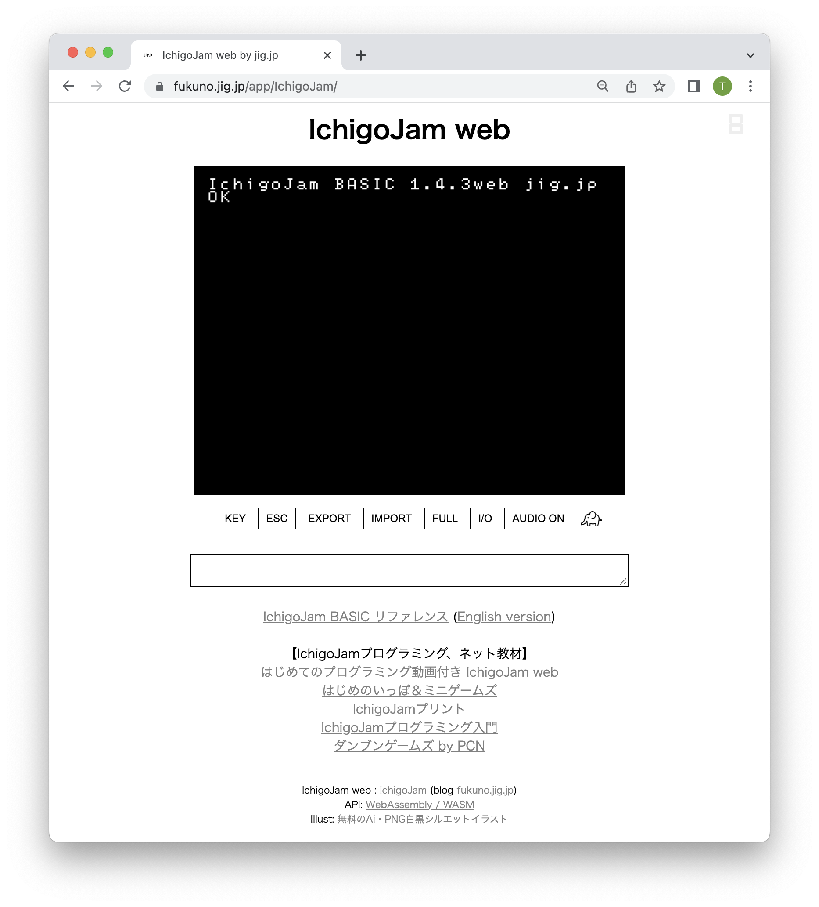
on your PC / smartphone
IchigoJam web
https://fukuno.jig.jp/app/IchigoJam/
DEMO

Slide 115


NHK
Ohayo Nippon
（Tokai Hokuriku）
2015.12.7
Mail notification if catch
Boars IoT
by Mr. Tanikawa
65 years old man
with IchigoJam

Slide 116
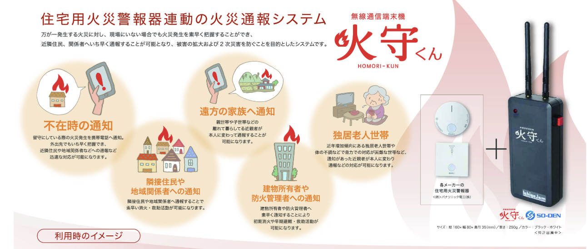
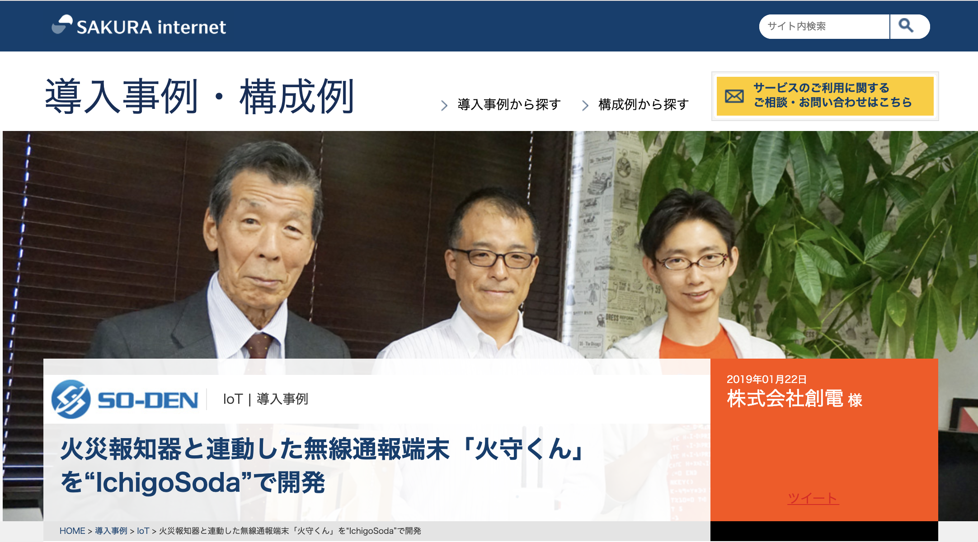
IoT x Fire Alarm by SO-DEN
IchigoJam programmed by
Mr. Tone, a president of SO-DE

Slide 117
AC auto control by temperature
Hearstroke
measures
https://fukuno.jig.jp/2952

Slide 118
You can make
Robots and Apps!

Slide 119

https://ichigojam.net/IchigoJam.html
Just
100 commands

Slide 120
Used commands today
LED : WAIT LIST RUN GOTO SAVE FILES LOAD NEW CLS LC RND BTN IF SCR END = + - & /
CLT TICK BEEP PLAY
26 / 100

Slide 121
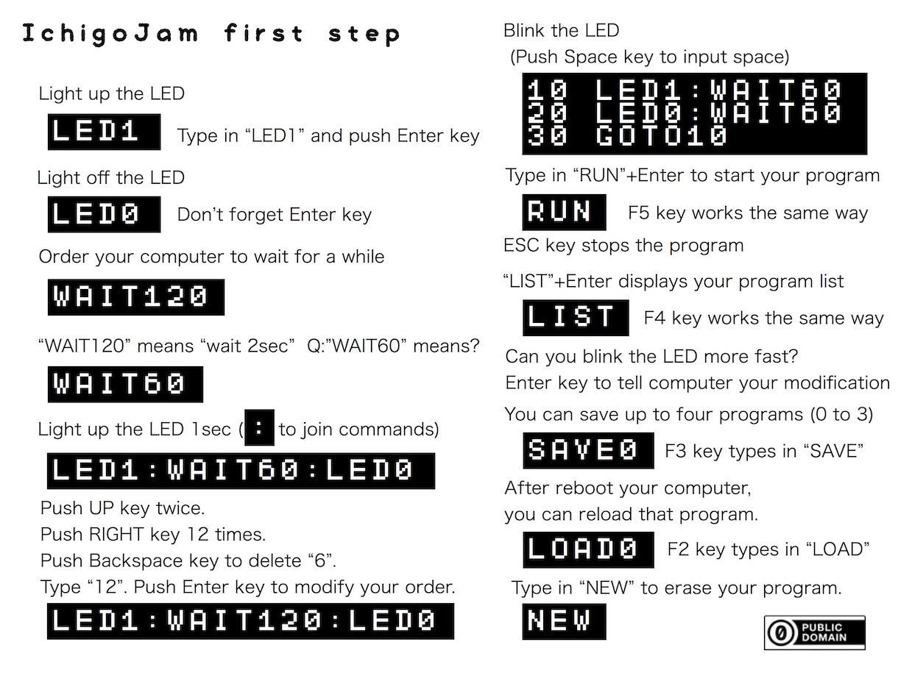

Slide 122
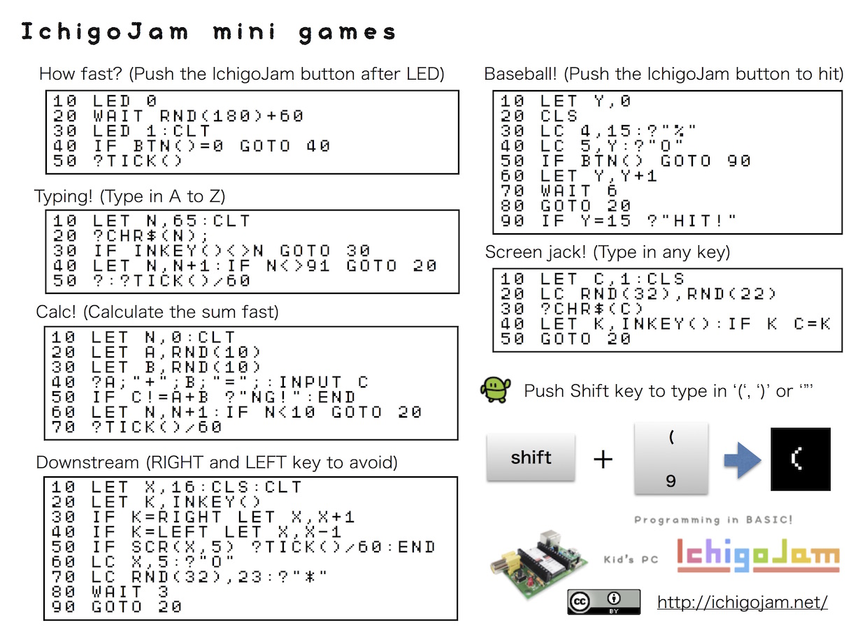

Slide 123
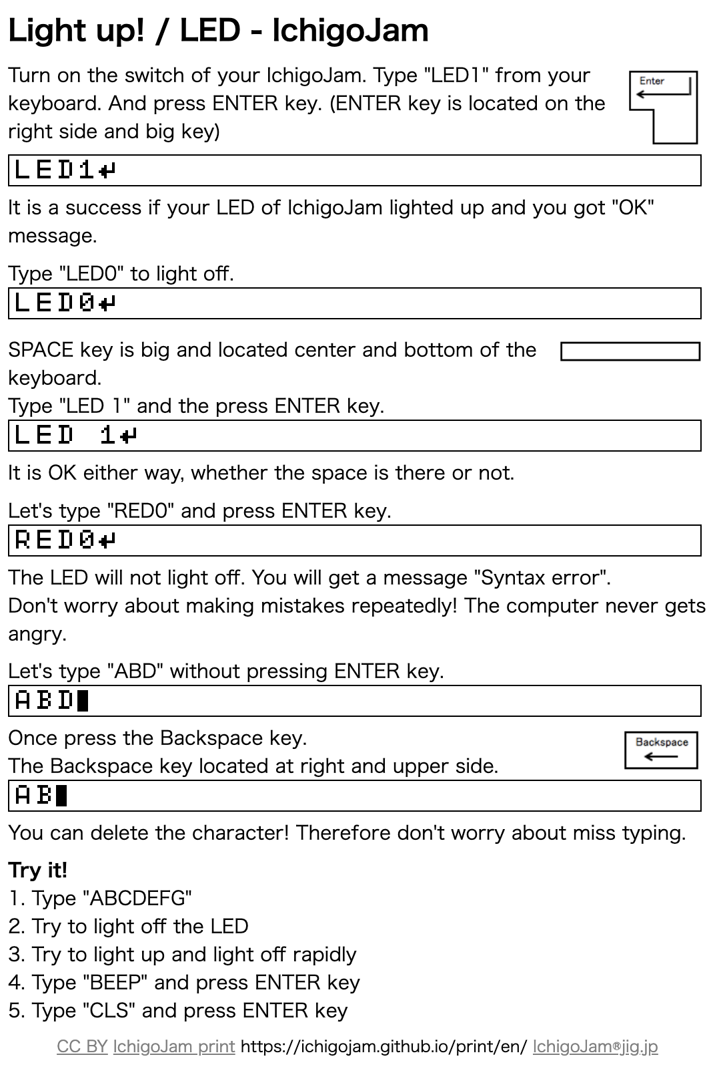

IchigoJam print
Edu materials for A5 papers
https://ichigojam.github.io/print/en/
Learn how to learn

Slide 124

For kids!
Let’s challenge
the contest
“PCN Kids
Programming Contest”
Let’s won the PC!
https://pcn.club/contest/
Sponsor-shipped by Japan gov and
companies

Slide 125
A machine to stop Smartphone overuse by mother
A awarded staff by 9 years old kidPCN

Slide 126
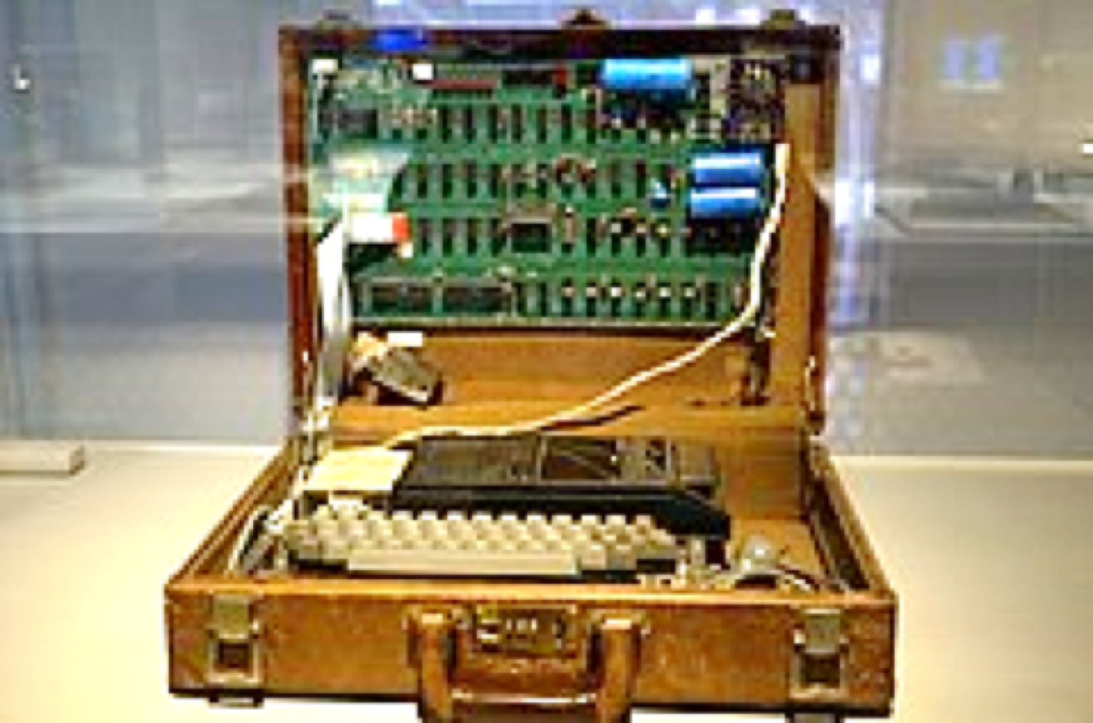
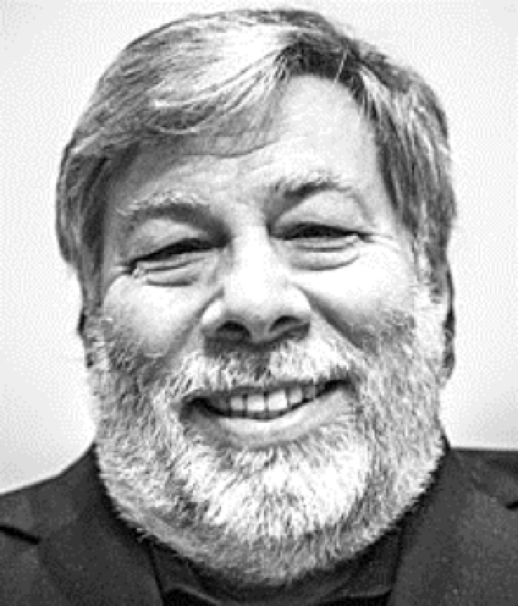
Apple I (1976)
iPhone company
Apple’s first product
from Wikipedia
Spec of IchigoJam is
almost same as Apple I
（price is 1/200）
Apple I developper - Steve Wozniak

Slide 127
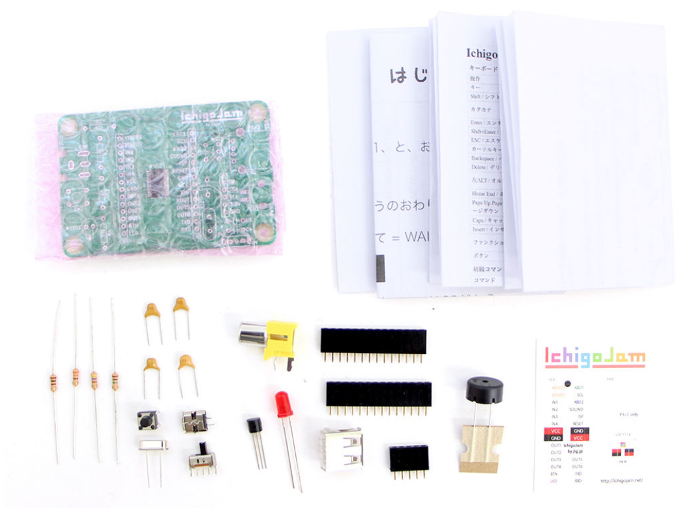
Make themselves PC
IchigoJam $15〜
Ichi Go
means 1 5 and
The strawberry in JP

Slide 128
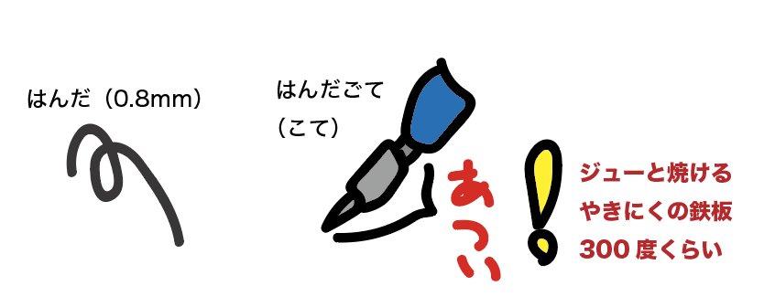
Let’s solder it!
Soldering
Iron
Solder
300degree(C)
As hot as BBQ griddle

Slide 129
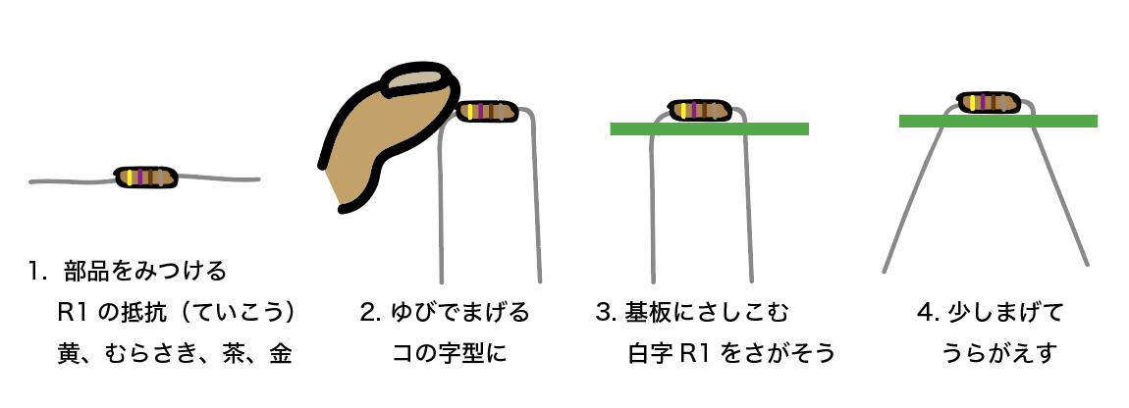
Let’s built it!
Pick a part
R1 is resister
2. Bend like
a U shape
3. Insert
into board
4. Bend a little and flip

Slide 130
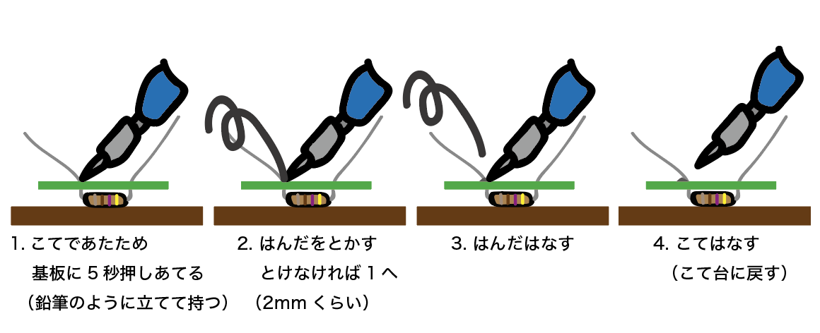
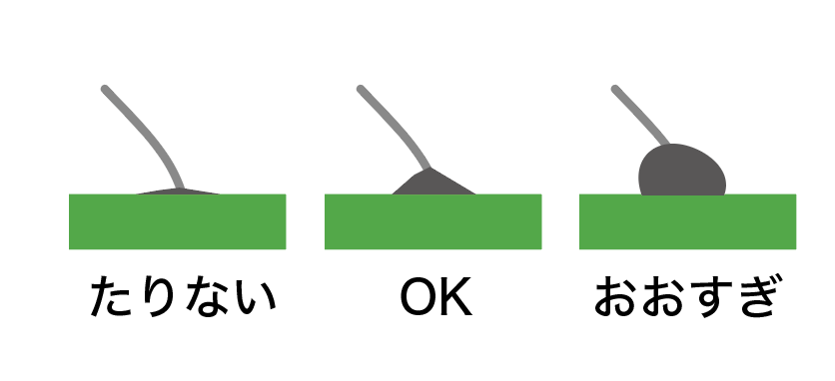
Soldering 4 steps
Warm
2. Melt
3. Apart
the solder
4. Apart the iron
Too few OK Too much

Slide 131
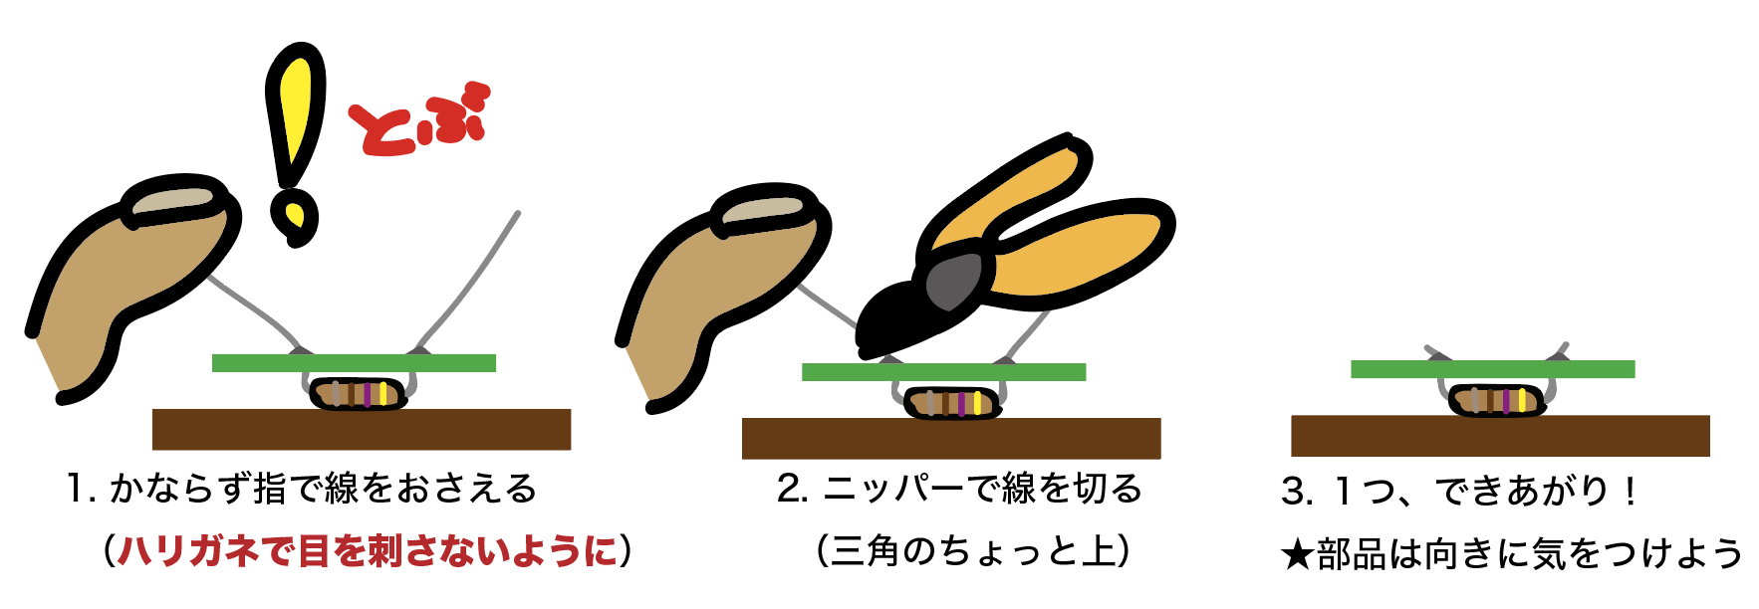
Nippers are more DANGEROUS than a soldering iron
Dangerous
To jump
Put your finger on it.
RISK: Eye damage
2. Cut with the nipper
3. One part is ready!

Slide 132
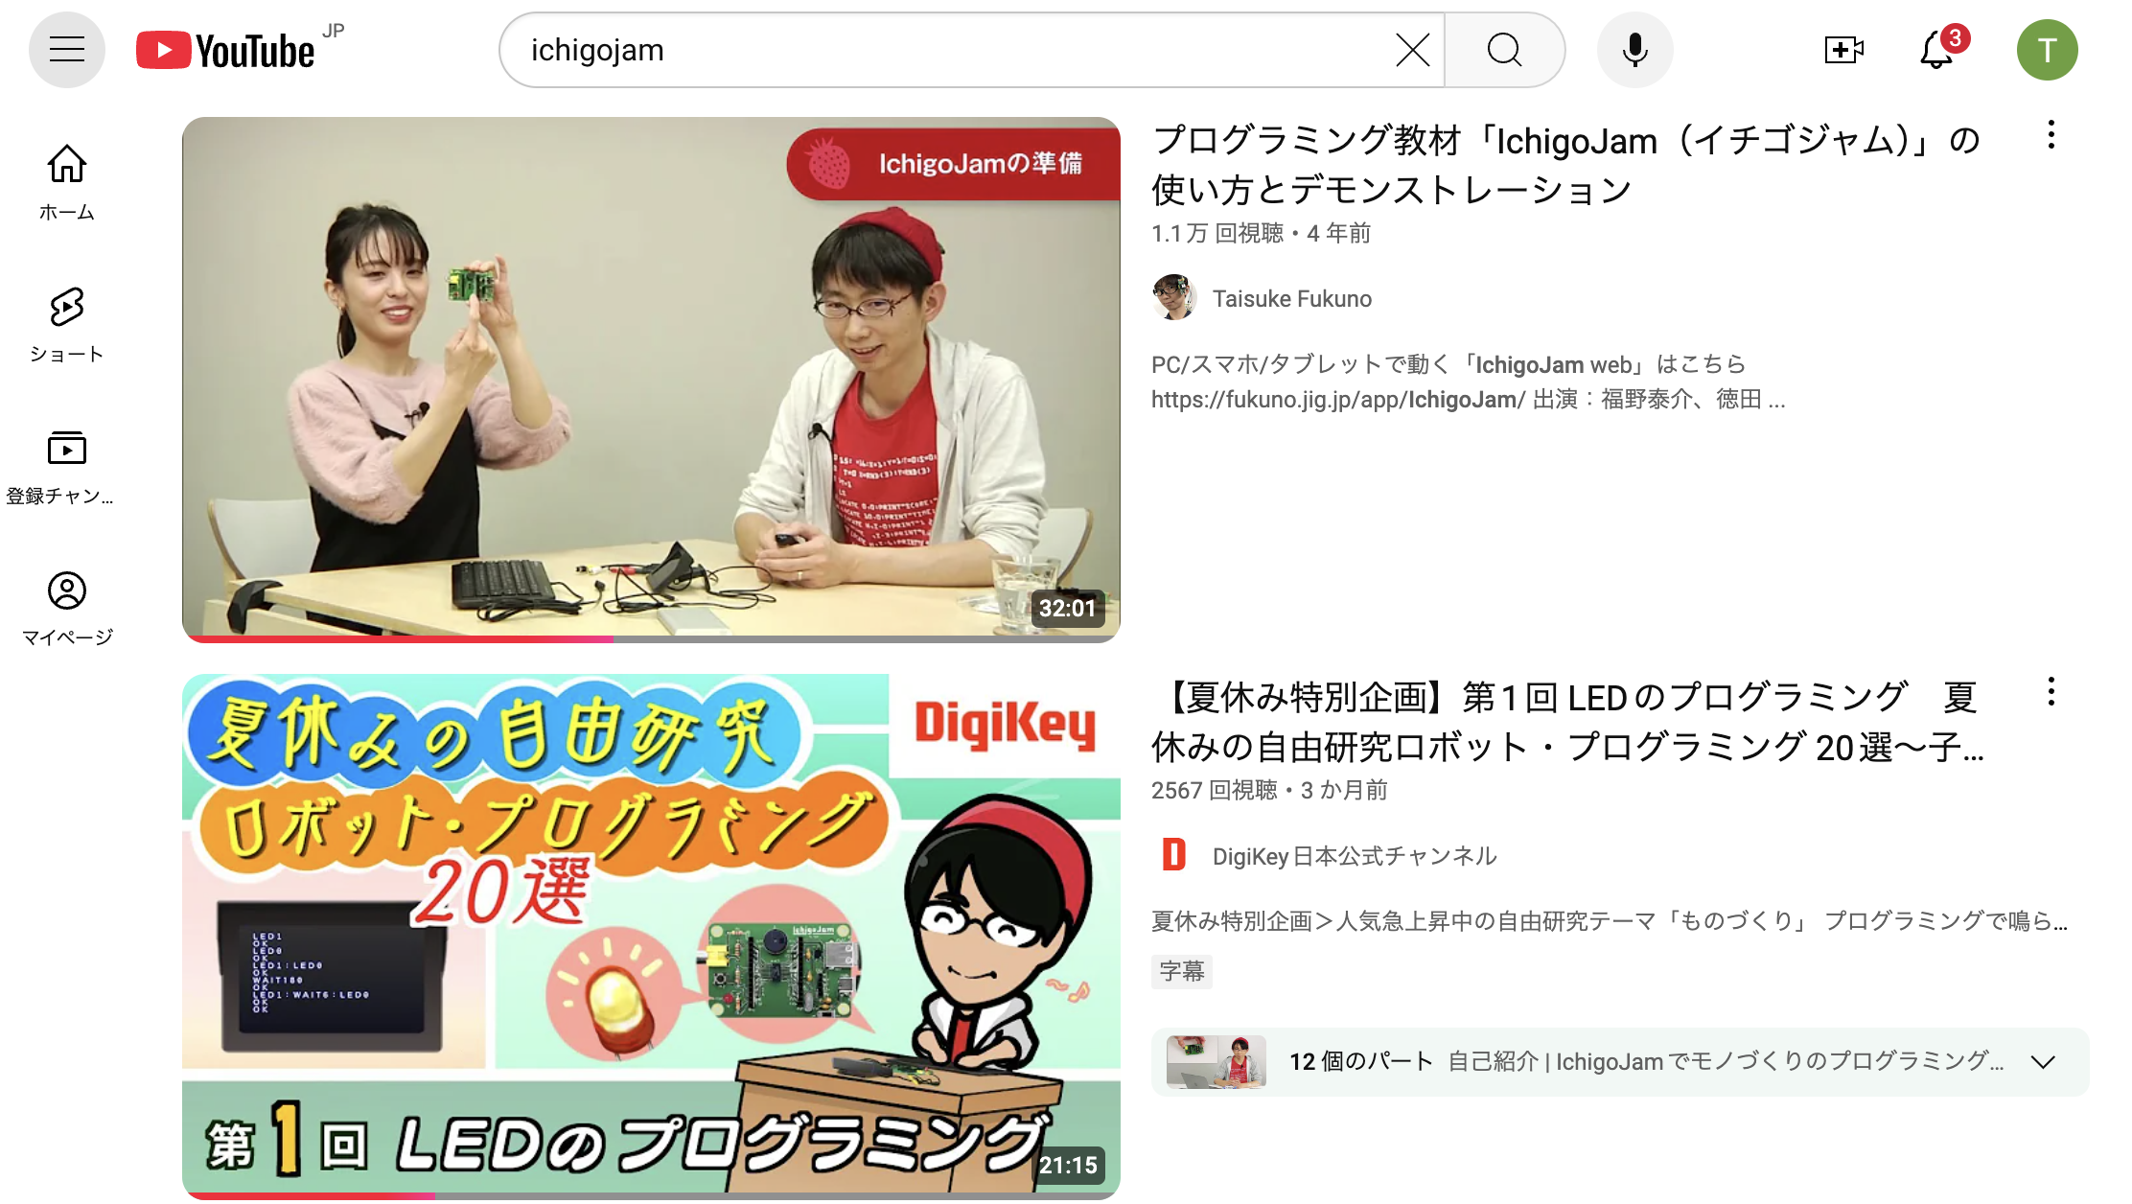
IchigoJam on YouTube

Slide 133
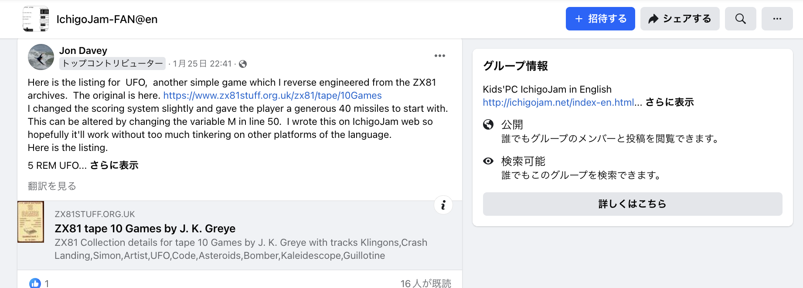

IchigoJam Community
Twitter #IchigoJam
Facebook group 「IchigoJam-FAN@en」

Slide 134

Join us PCN (Programming Club Network)

